Slide 1
Cardiovascular Diseases
Early Detection
Machine Learning
Application on

Slide 2
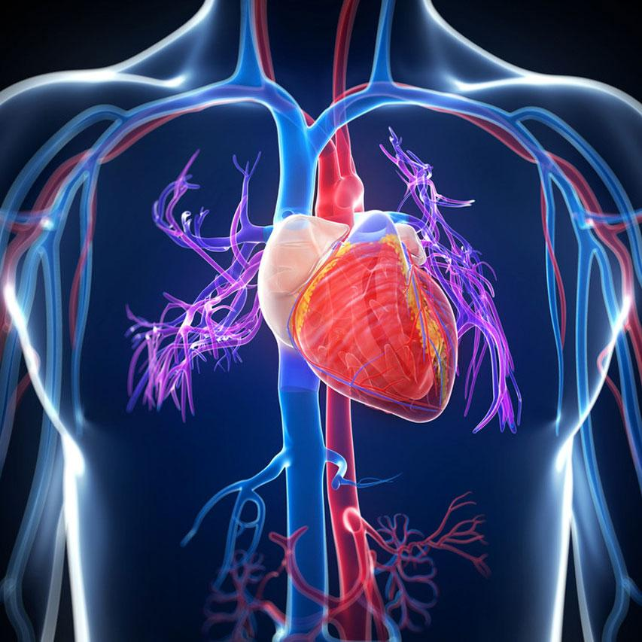
Cardiovascular disease
is the leading cause of mortality worldwide, it would be beneficial to have an algorithm for its early detection.

Slide 3
Goal for this Assignment
Be able to detect the presence or absence of cardiovascular disease early depending on variables such as patient's age, gender, physical activity and more.

Slide 4
Analysis phase of the project
Machine Learning Models
Logistic regression
Decision trees and random forests
Support Vector Machine (SVM)
Neural Networks
01

Slide 5
Logistic Regression Performance
Accuracy Score: 71.43%
Goal: to find the probability of existence or absence of cardiovascular disease.
Pros: very simple and fast to implement
Cons: wrongly assumes a linear relationship; only works on simple models

Slide 6
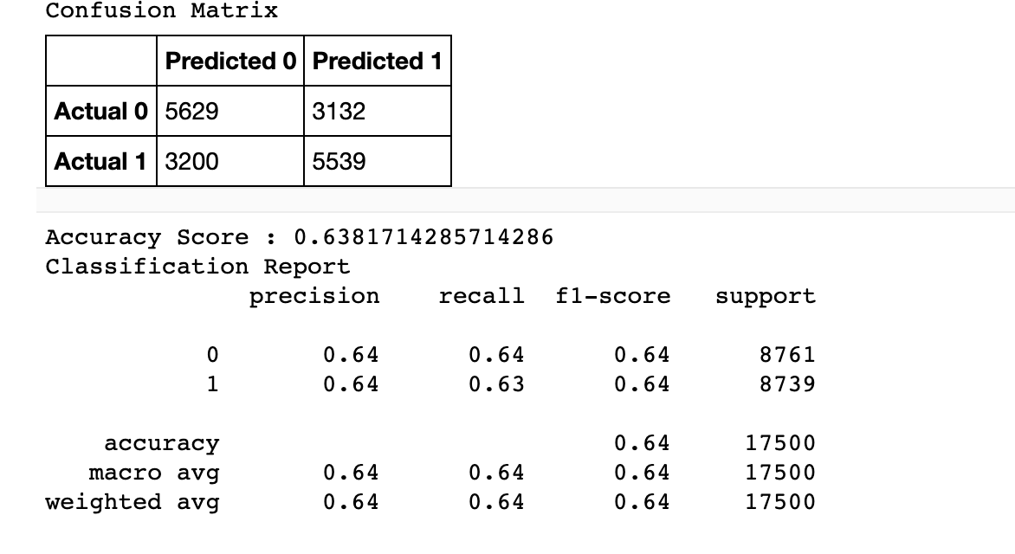
Decision Trees
Accuracy Score: 63.82%

Slide 7
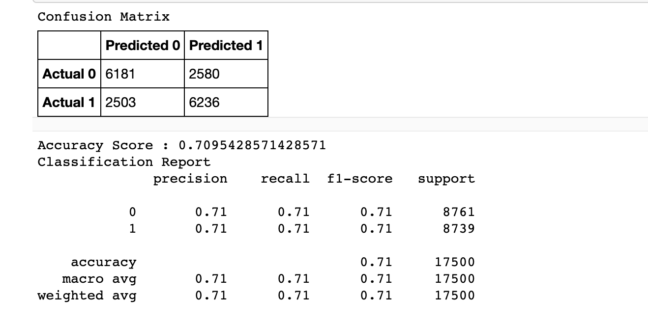
Random Forest classifier
Accuracy Score: 70.95%

Slide 8
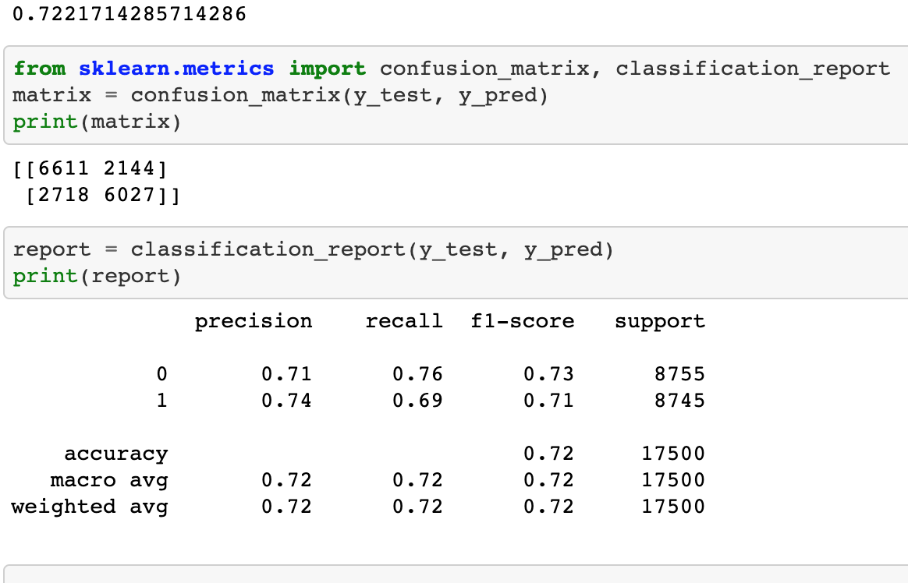
SVM
Accuracy Score: 72.22%

Slide 9
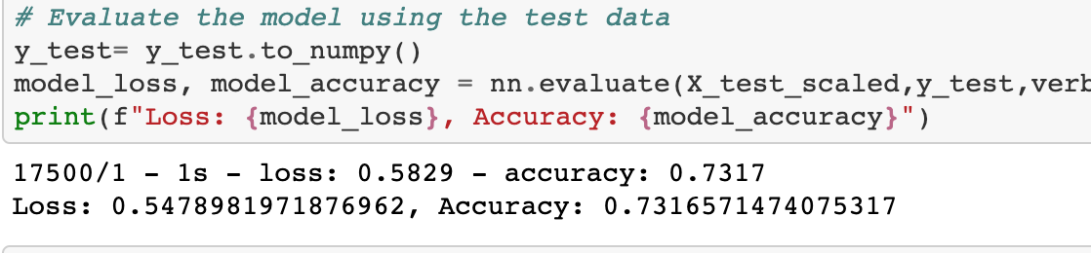
Deep Learning Neural
Accuracy Score: 73.16%

Slide 10
Network Neural network model
Best Accuracy: 73.17%
Most advanced: layers of neurons performing individual analysis

Slide 11
Data exploration phase of the project
02

Slide 12
Data exploration phase
Selecting Sample Data
Preprocessing Sample Data
01
02
03
04
05
Collecting Raw Database
Understanding Sample Data
Splitting into Training and Testing

Slide 13
Collecting & Selecting Sample Data
Selecting Sample Data
Source of Data:
In the original dataset, a total number of 70000 records were presented with 12 columns of information
This data is extracted from Kaggle.com, which is an online community of Data Scientists and Maching Learning practitioners.
In order to efficiently process the data without losing the statistics significance, we shrink the number of record to 700 as the selected data shows a uniform distribution with respect to our dataset.

Slide 14
Understanding Sample Data
01 02 03 04 05
Numerical Variables
Age Height Weight Low Pressure High Pressure
01 02 03 04 05 06
Gender Cholesterol Gluc Smoke Alcoholic Active
Categorical Variables

Slide 15
Preprocessing Sample Data
Unique ID column
Null Column
Age group column
Number and types of columns
to avoid duplicate data and to set the unique indexes for each record.
was tested for null values in order to remove those columns
was removed from the set as it does not bring any new information and duplicating existing information could cause problems for our model.
were listed in order to verify their compliance with the model's requirement

Slide 16


Splitting into Training and Testing
Testing sets: evaluate the model's performance
Training sets: run the model or learn from it

Slide 17
Technologies, languages, tools, and algorithms
03

Slide 18
Communication Tool
Language
Dashboard
Database
Zoom and Slack
Python
Webpage (HTML)
SQL database

Slide 19



A Web Page
Big Picture for the Final Dashboard
Our goal is to create a interactive Web Page where the user can input variable to predict the possibility that whether or not they will have Cardiovascular diseases

Slide 20
SECTORS in Web Page
Background
Machine Learning Models
Smart Form
Tips Box
Biography
Information and some facts about Cardiovascular disease
We will choose the best performance models to predict the Cardiovascular disease for our user
User can input their information including weight and height so we can give them prediction of the possibility of having Cardiovascular disease
Based on the probability of having Cardiovascular, we will give user different tips based on their level of risk
We will give brief introduction to each member of this team, including their biography and contribution to this team

Slide 21
Tools to Create the Web Page
HTML and its attributes
Flask
SQL Database
Graph, Titles, paragraph and add-in tool -- this is where the magic happens!
To build the framework for the web page. The web application will be using Flask routes to add function and interactive elements that allows the user to perform multiple actions
To store and display the data set that the user have inputted

Slide 22
HTML and its attributes
01
03
02
Graphs
Interactive Elements
Words
Input box to put user’s data, analysis form that concluded based on the data user inputted, and biography section for each member of the team
We will give: screenshot of our model performance, background knowledge for our topic and of course fun pic to cheer you up!
We will give explanation about purpose of this project, insights we discovered from models and application can be used for future analysis

Slide 23
Mongo Database
Store
01
Display
02
Mongo database will be used to store the information that user inputted in the smart form
It is also crucial to display the data once we have predicted outcome data available. Essentially our goal is to present the result to our users

Slide 24
Flask
Flask will be powerful tool to make the magic happen. We will use Flask to write python code to:
Scraping the data collected from input box and use the data to the machine learning models
Calculate the possibility of having Cardiovascular disease
Based on the possibility number, determine its Risk Level
Depending on the Risk Level, the web page pop out health suggestion

Slide 25
Interactive Element
04

Slide 26
Smart Form
Goal:
Information will be collected
Variable:
Gender, height, weight, smoker or not, etc
Interact:
Input box for the numerical variable; Buttons for the categorical variable
Result:
By using the machine learning models, probability will be calculated based on the information

Slide 27
What’s next?
Analysis
Tips Box

Slide 28

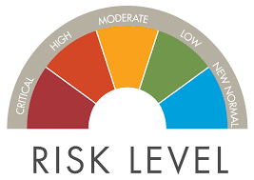
Tips Box
Level of Risk
Advise on Health
Low, Medium and High level of risk will be given based on the possibility calculated
Depending on the level of risk, different suggestion on keeping healthier life will be given

Slide 29
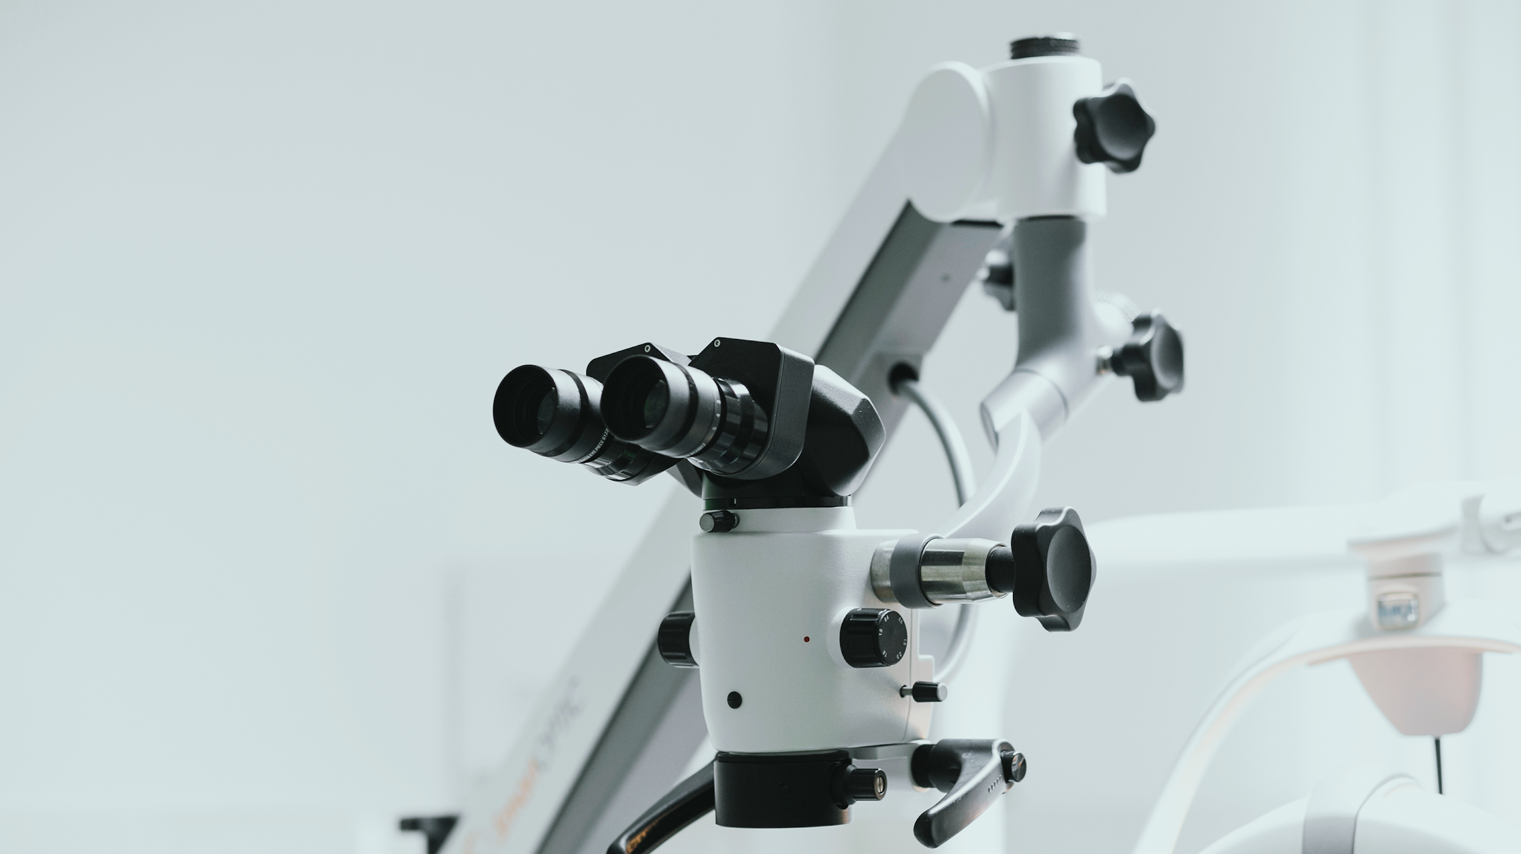
Analysis
Facts and Video
Facts will be presented as proof to support our health suggestions

Slide 30
Thank You

